Slide 1
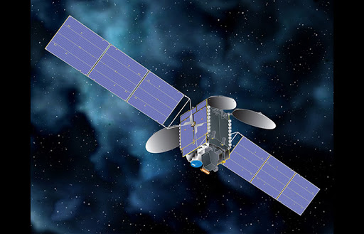
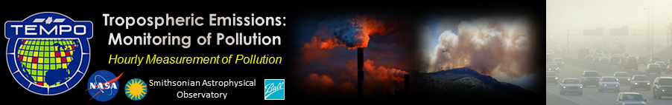


TEMPO High-resolution tracking of NO₂ /CH₂O emissions during high O₃ episodes over NYC
Michael Geigert
Bureau of Air Management

Slide 2
Using TEMPO to Monitor Emissions Over NYC
After reviewing data from the Long Island Sound Tropospheric Ozone Study (LISTOS 2018), it was apparent that the area around NYC emits noticeably larger amounts of NO2 on days that monitor elevated ground level ozone.
Because Connecticut continues to monitor the highest ozone design values on the East Coast, it is vital that the source, strength, and timing of the ozone precursors be determined, especially during the ‘ozone season,’ which typically occurs between May 1 and September 30.
Although the TEMPO spatial resolution will not match the 250 meter resolution of the GCAS images, the instrument would be able to scan more frequently (10 minute time intervals) and produce spatial resolution images greater than the nominal 2.1 km x 4.7 km pixel size.
In addition to the point source EGU plumes, it would be useful to determine contributions from mobile source emissions (NO2, H2CO, and C2H2O2) along major highways and from marine vessels in shipping channels and along the land/water interface.
Furthermore, with the geostationary TEMPO measurements, it would be highly informative to track NO2 emissions activity over time in the study area during daylight hours spanning multiple days of a high ozone episode.

Slide 3
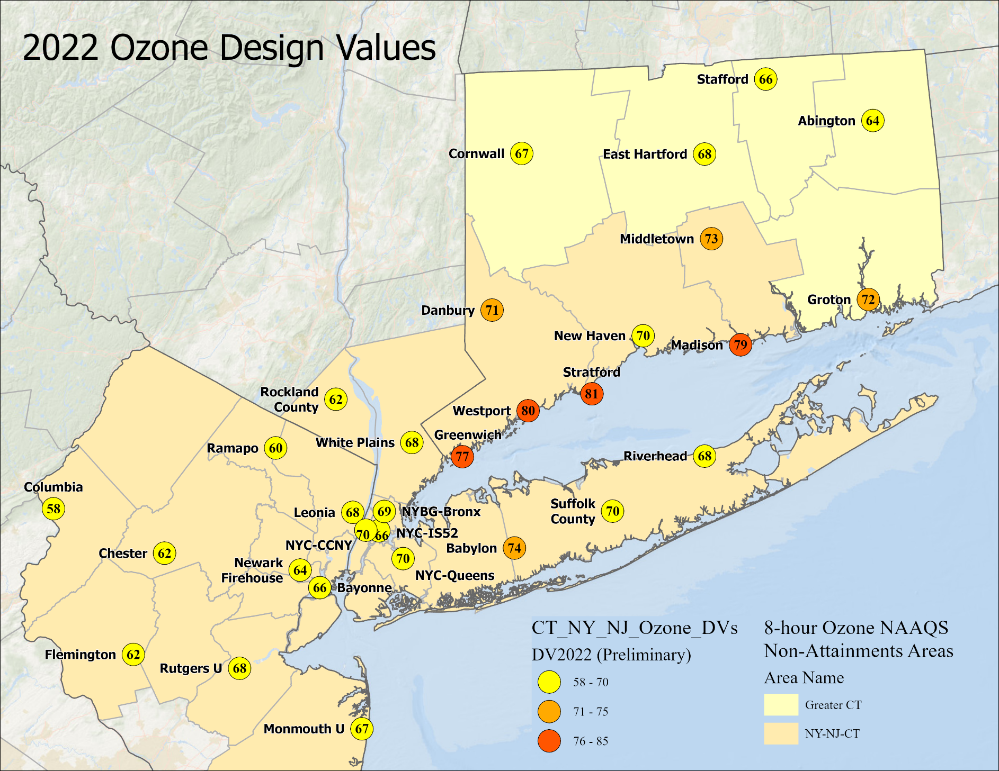
Ozone Design values
To reach attainment for the current ozone standard, the design value (3-year average of daily 4th highs) must be no greater than 70 ppbs.
Connecticut coastal sites continue to record the highest ozone design values on the east coast.

Slide 4
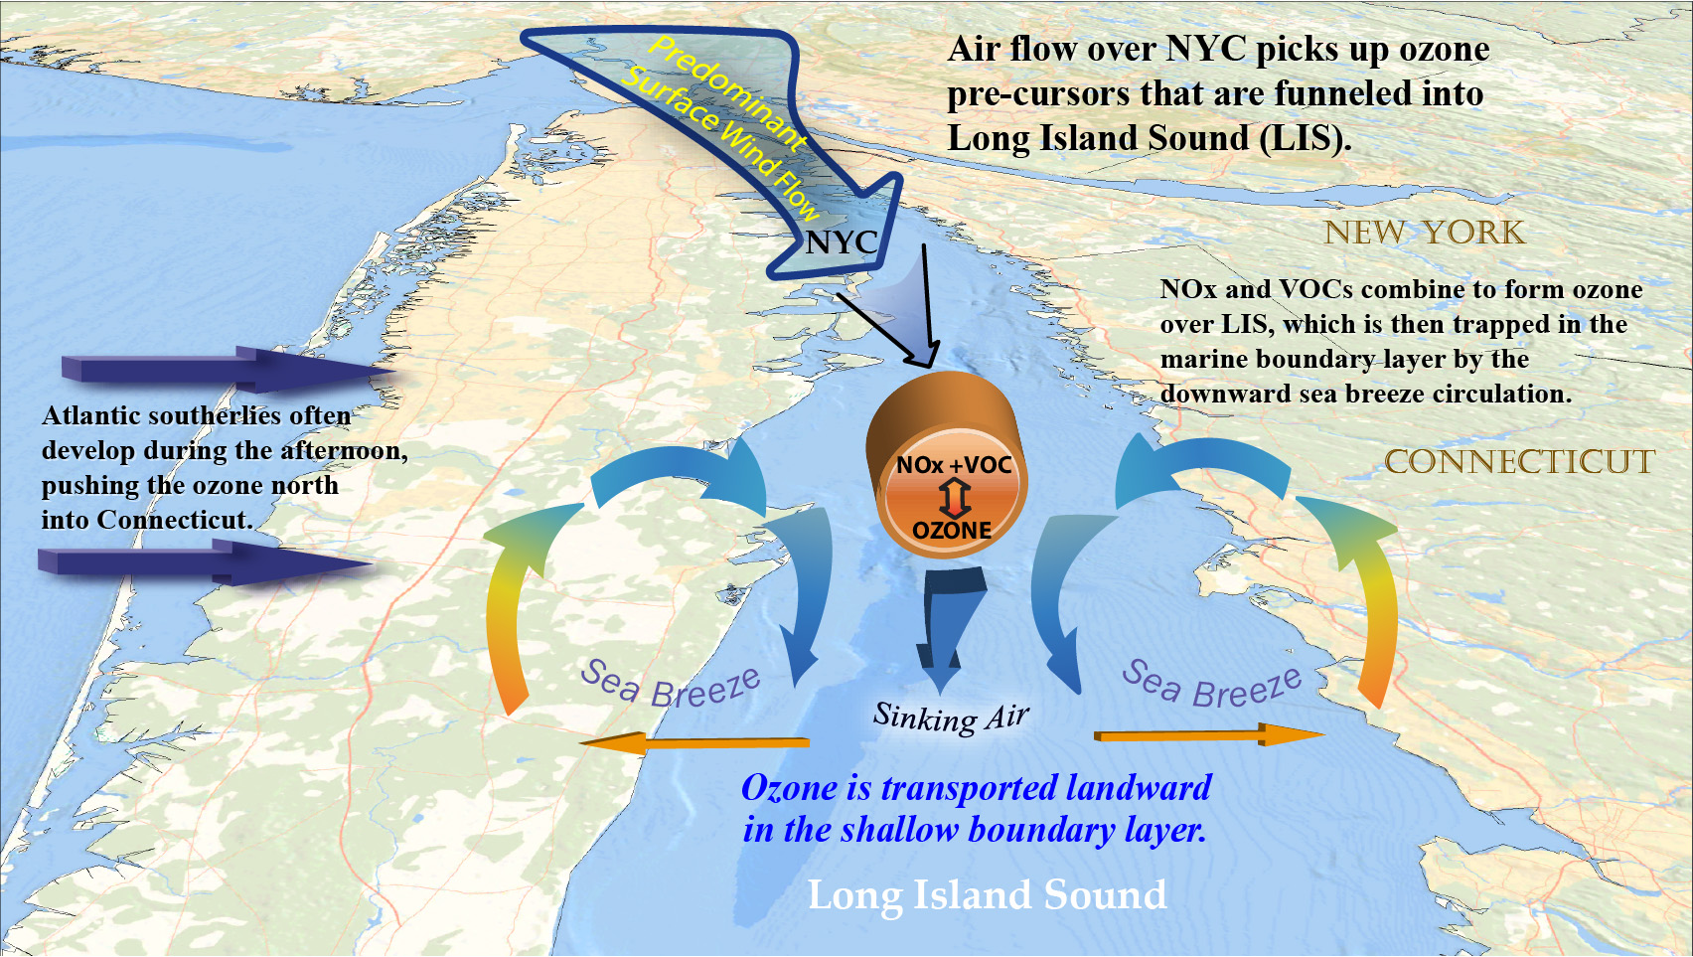
Conceptual Model of Ozone Transport into LIS

Slide 5
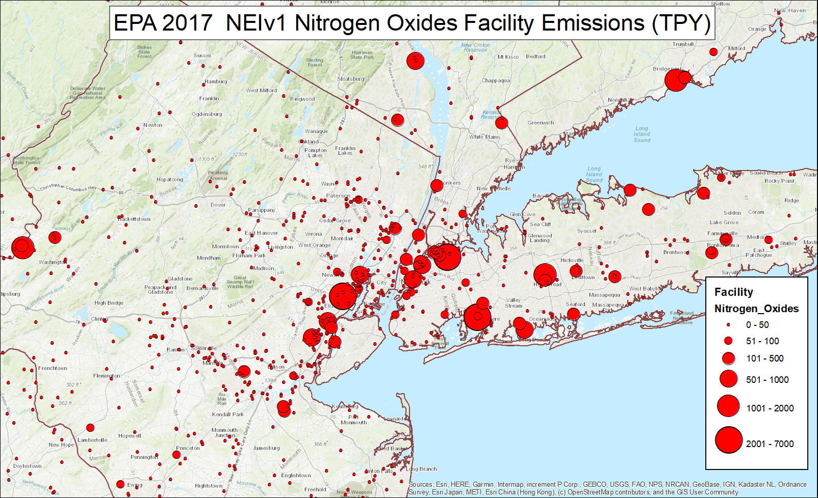
Monitoring Emissions Over NYC
We have a good idea where the point source NOx emissions come from, but that is only part of the equation. (2017 EPA National Emissions Inventory ‘NEI’)
To develop better NOx control strategies, we need to know where the emissions come from on high ozone days.

Slide 6
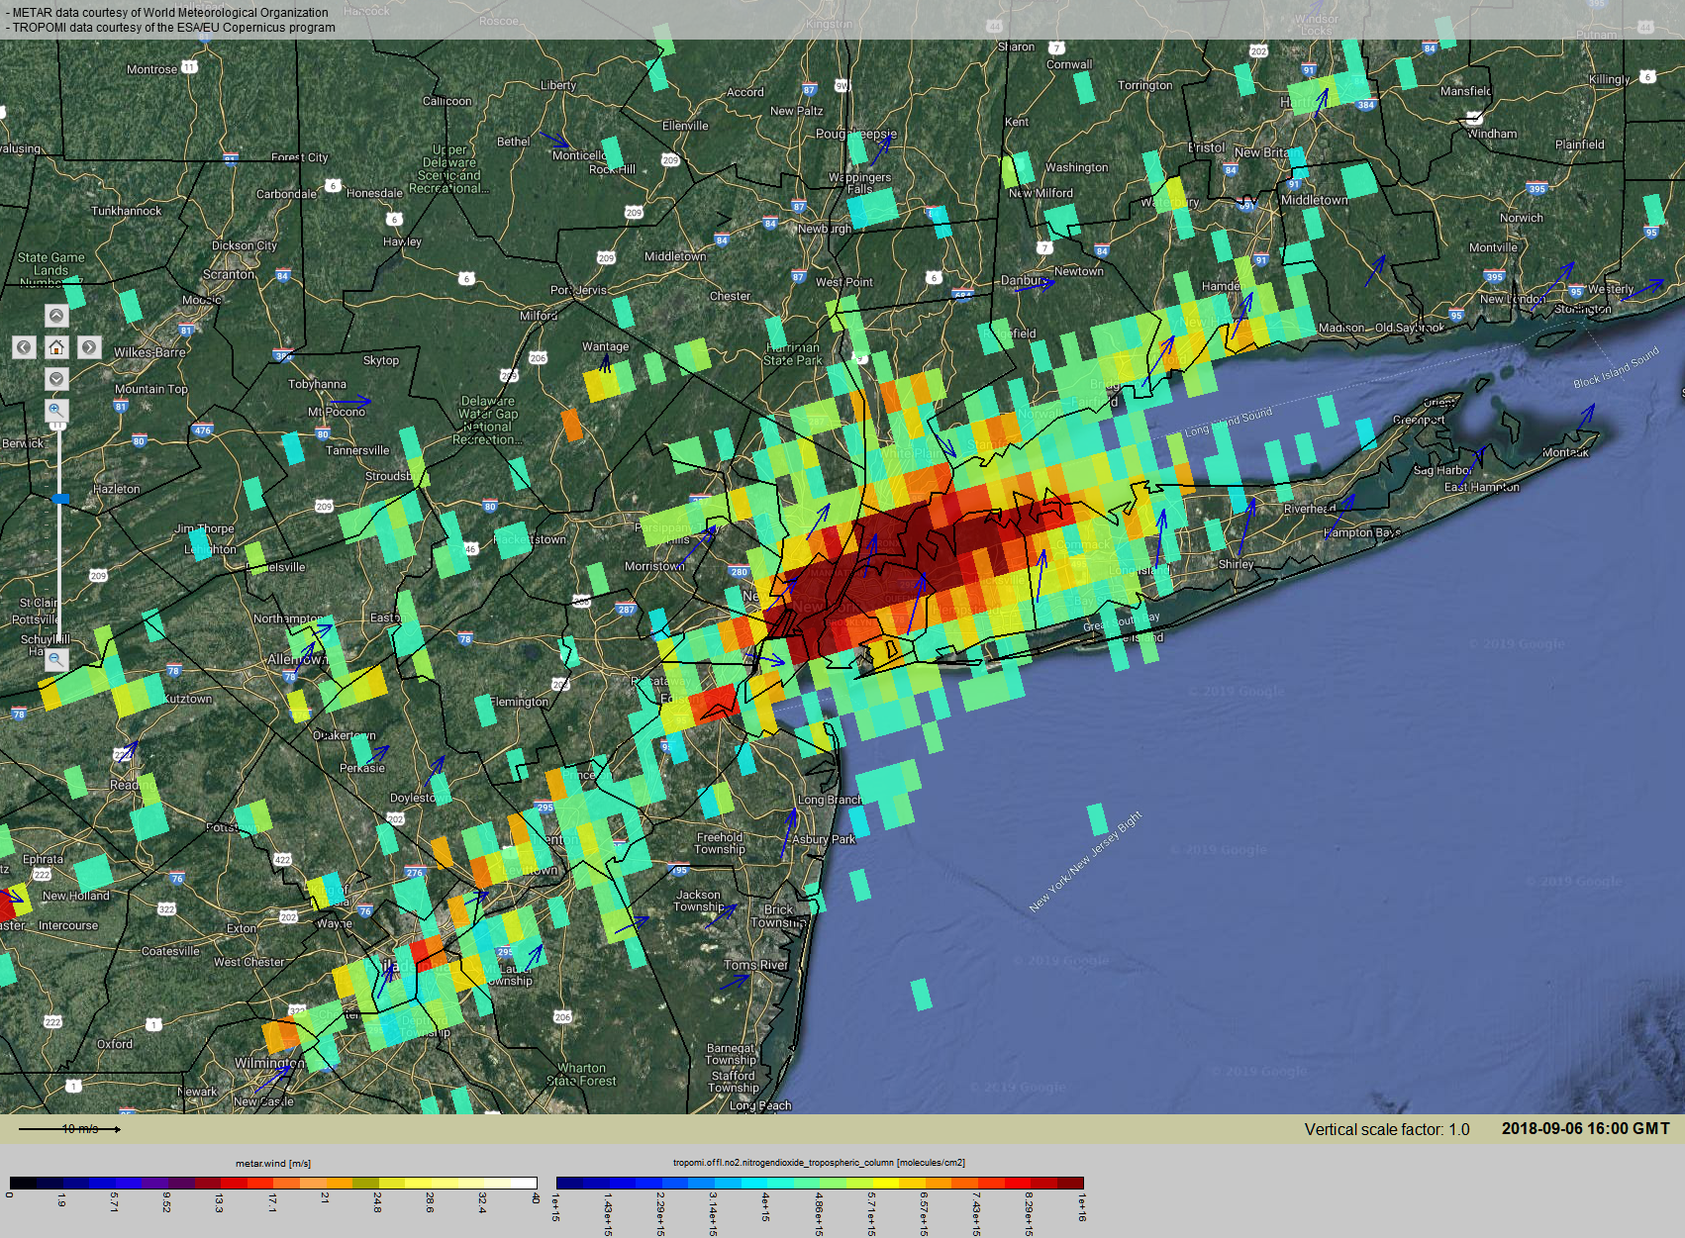
September 6, 2018 TROPOMI NO2
The TROPOMI satellite was operational during the LISTOS study and verifies the elevated NO2 around NYC.
However, it does not have the resolution to capture the individual NO2 point source plumes.

Slide 7
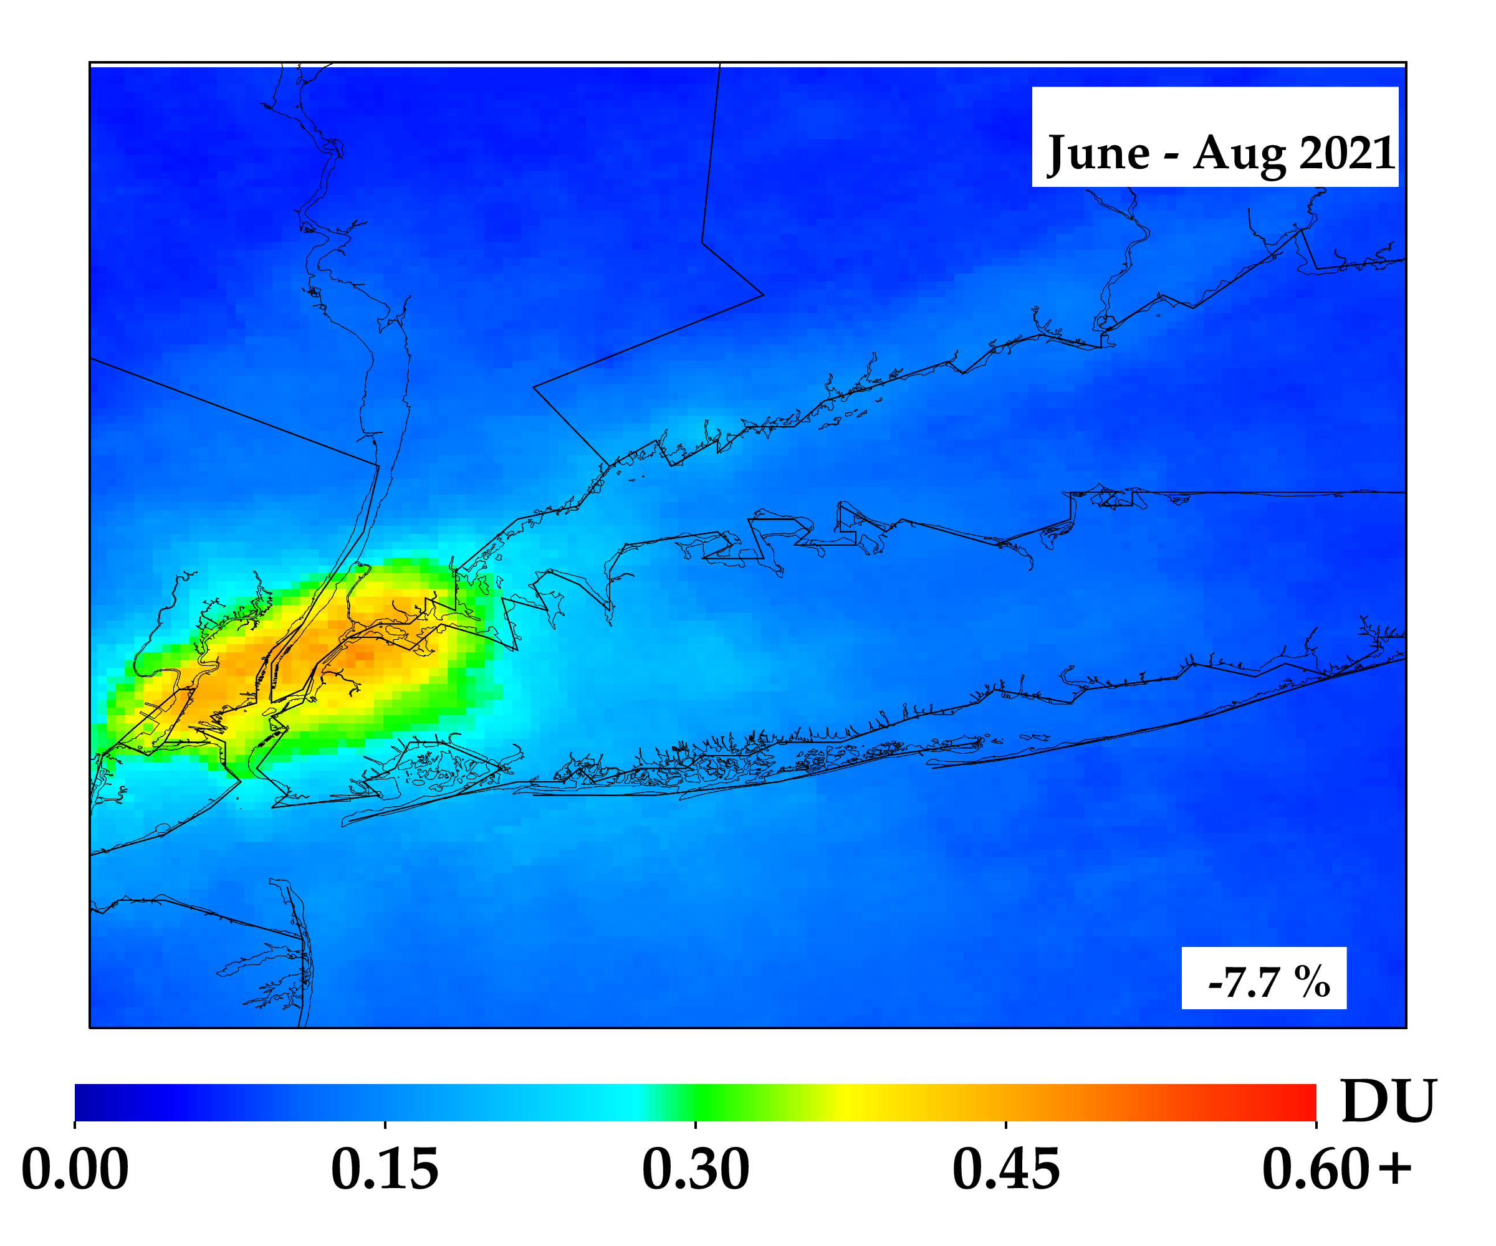
TROPOMI NO2 Trends
Using averaging techniques over seasonal time periods, higher resolution images can be produced.
However, TROPOMI still cannot capture the individual NO2 point source plumes over such a long averaging period.
It is hoped that daily over-sampling techniques with TEMPO will be able to better resolve the sources.
NO2 Trend from June-Aug 2018 Baseline
Image courtesy of Dr. Dan Goldberg, GWU.

Slide 8

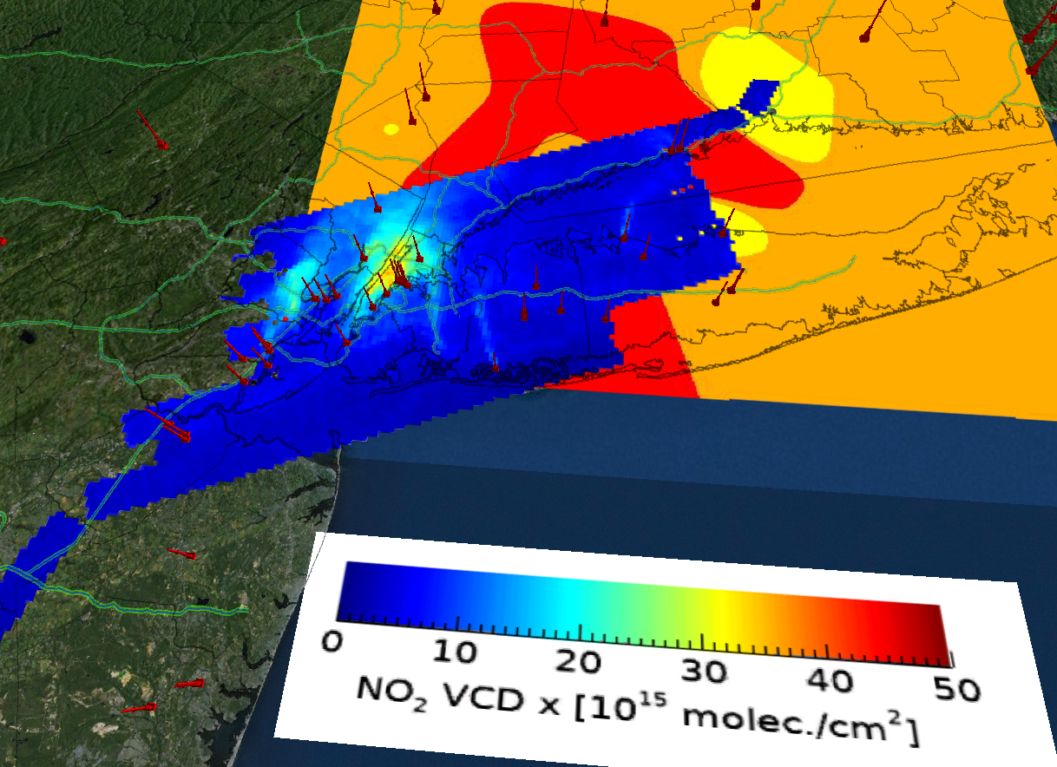
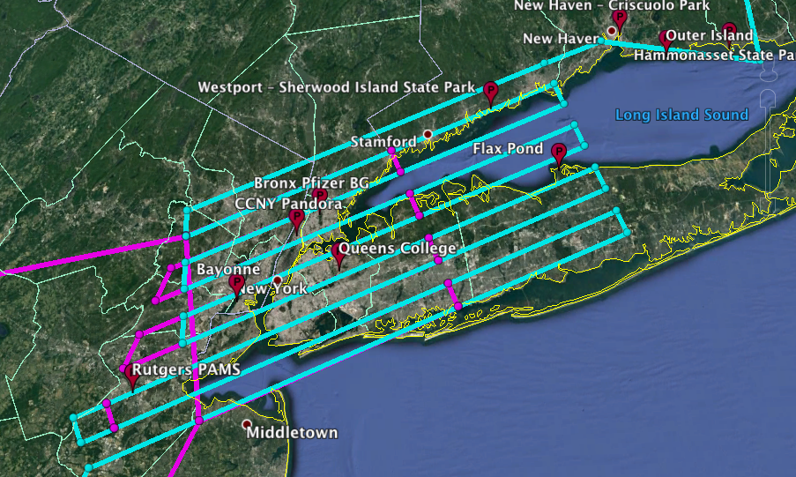
2018 LISTOS NASA GCAS Flights Over NYC
Nowlan et al., 2016
The NASA flights ( 30,000 feet) used the GCAS instrument, and flew a grid pattern around NYC that had a resolution of 250 meters.
Unlike the TROPOMI satellite, this resolution could pick out individual point source NO2 plumes.
By plotting NO2, CH2O and the CH2O /NO2 Ratios for high ozone days, these snap shots can help us determine how close the NYC area is to the ‘tipping point’ for a NOx sensitive regime.

Slide 9
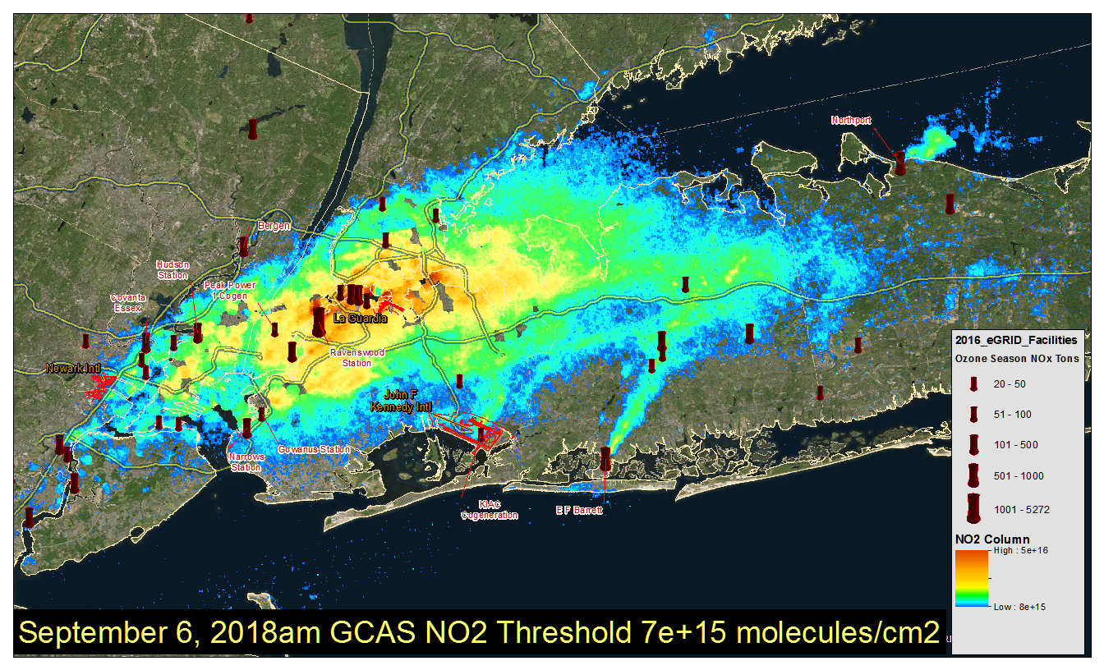
September 6, 2018 LISTOS GCAS NO2
This high resolution image clearly shows NO2 emissions coming from several point sources on a high ozone day. The pixel resolution of 250 meters was ideal for locating these NO2 sources.

Slide 10
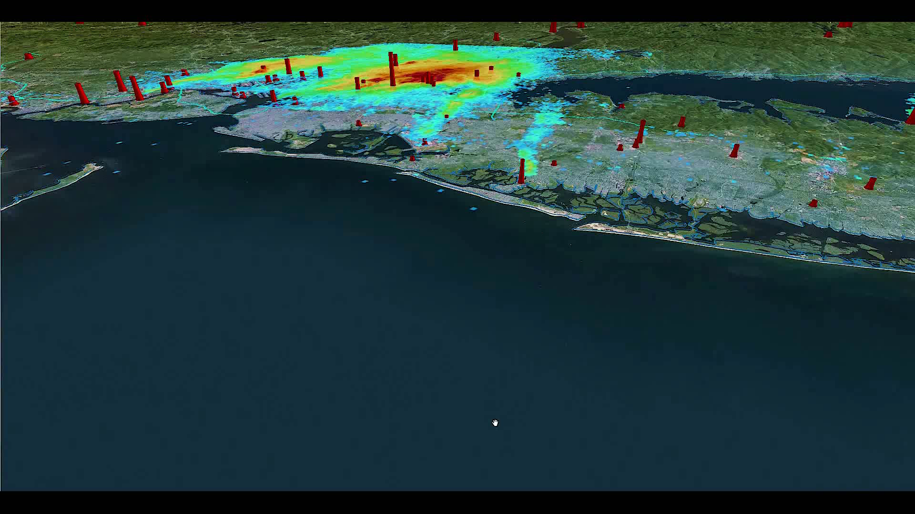
July 2, 2018 GCAS NO₂ NYC Flyover Animation
This animation with the GCAS NO2 plotted with the EGU stacks around NYC shows much of the NO2 plumes coming off the EGU stacks and airports on the afternoon of July 2, 2018. On this day, very high ozone levels were measured to the north of NYC.

Slide 11
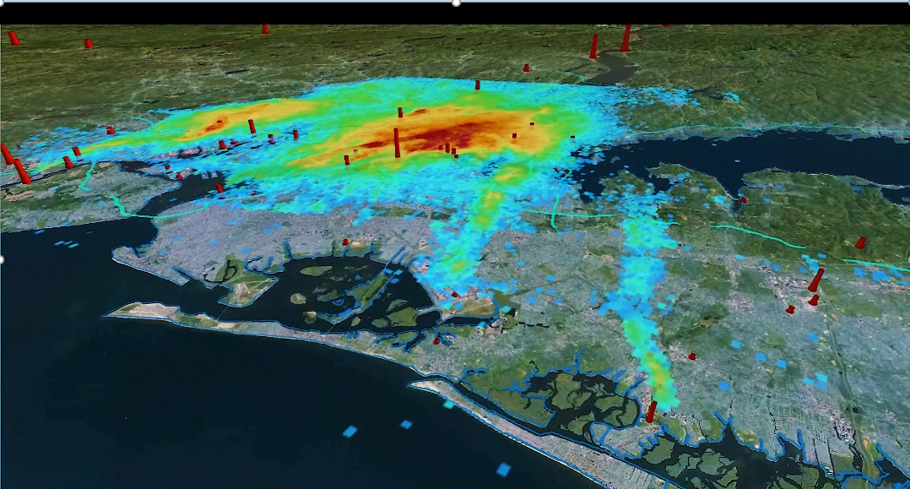
July 2, 2018 GCAS NO₂ NYC Flyover Close-up

Slide 12
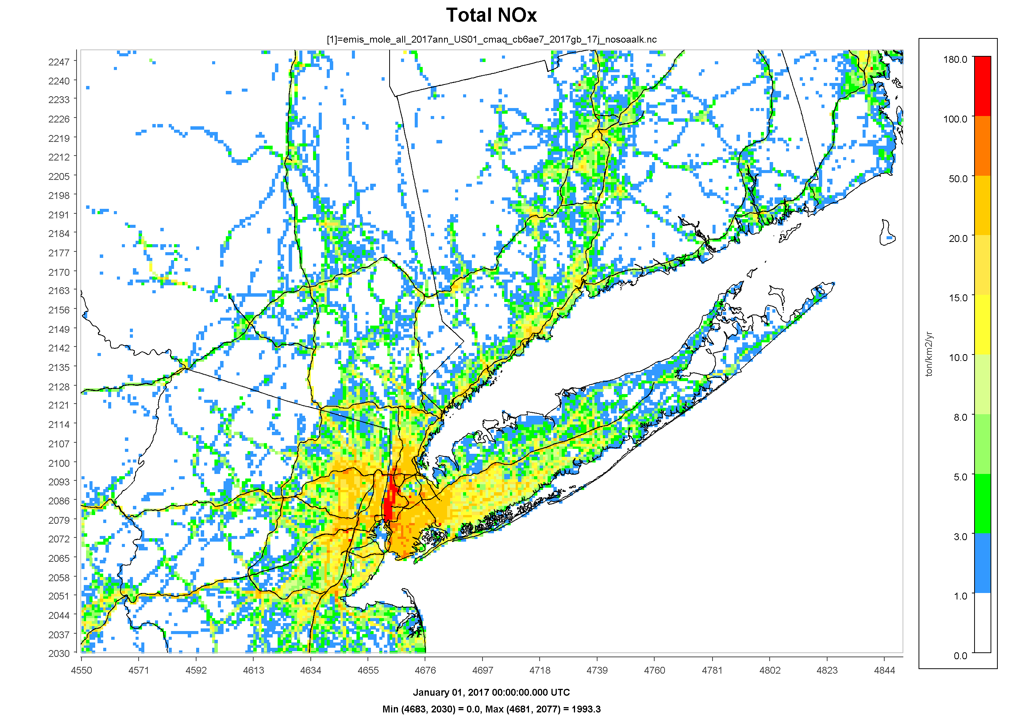
High Resolution NOx Inventory
This 1km annual regridded 2017 NEI NOx inventory clearly shows emissions along major highways and urban areas. It would be valuable for TEMPO to attempt a high resolution mapping of NO2 sources to help verify the EPA inventory. Courtesy of Neighborhood Emission Mapping Operation , Dr Daniel Tong GMU.

Slide 13
Conclusions
It would be very valuable to have these ~10 minute scans during the morning hours over NYC to show the position and strength of the NO2 plumes and to track their movement over the land/sea interface.
These would also complement the afternoon TROPOMI overpasses, since morning meteorology produces different patterns of pollutant dispersion.
It would be preferable to use an over-sampling technique to improve the spatial resolution (~1km) enough to single out point sources of emissions .
High ozone events appear to have become more of a local issue for Connecticut, rather than regional. This shows that NOx reductions have been effective on a regional scale, but still are needed in large urban areas.
Using TEMPO to provide high resolution imaging during high ozone days over the NYC area would be invaluable to air quality managers in developing better control strategies.

